Slide 1
SMART INDIA HACKATHON 2020
ST.JOSEPH’S COLLEGE OF ENGINEERING AND TECHNOLOGY, THANJAVUR, TAMILNADU.
TEAM NAME:WOMEN SELF DEFENCE
TEAM MENTOR :MRS.DR.D.MERCY Phd
TEAM LEADER :S.SANGEETHA
TEAM MEMBERS:
M.KAVIYAARASAN E.MANIKANDAN
S.VENKADESH A.VINODHINI
S.SOWNDHARYA

Slide 2


PIC BASED SELF DEFENCE SYSTEM FOR WOMEN SAFETY

Slide 3

WIRELESS COMMUNICATION

Slide 4
WORK FLOW CHART

Slide 5

PROBLEM STATEMENT
Now a days women facing lot of problems.
In this world crimes against women is increases
Day by day.
So main theme of my project is to build a
security system for women that is Completely
automated and requires no human Interference.

Slide 6

ABSTRACT
This paper describes about safe and secured electronic system for women . This device is a security system especially designed for women in distress.
It comprises of PIC controller, wrist band, Microphone, Webcam, Buzzer, LCD, GSM and GPS are used in this project.
This security system is provides self confidence to the women. That also empowers power to the women. So crimes against women are decreased.

Slide 7

LITERATURE SURVEY
TITLE | YEAR | AUTHOR | METHOD
Design and Implementation of Safety Armband for Women and Children using ARM7 | 2015 | 1.Gilenson Toney 2.DR.Fathima Jabeen 3.Puneeth.S | ARM processor
Smart Electronic System for Women Safety | 2016 | 1.S.Shambhavi 2.M.Nagaraja 3.M.Z Kurian | Embedded(IOT)

Slide 8
LITERATURE SURVEY
TITLE | YEAR | AUTHOR | METHOD
Smart Security Solution for Women based on Internet of Things | 2016 | 1.G.C Harikiran 2.Karthik 3.Menasinkai 4.Suhas Shirol | AVR Microcontroller
Intelligent Safety System for Women Security | 2017 | 1.Sutar Megha 2.Ghewari M.U | Arm controller
Smart Women Safety System | 2018 | 1.Anup C J 2.Saminathan K 3.Gobinath M 4.Senthilrajan | GSM GPS Zapper Circuit

Slide 9

SYSTEM DESCRIPTION
Sound sensor
MEMS accelerometer
Buzzer
LCD module
Tilt sensor
Microphone

Slide 10
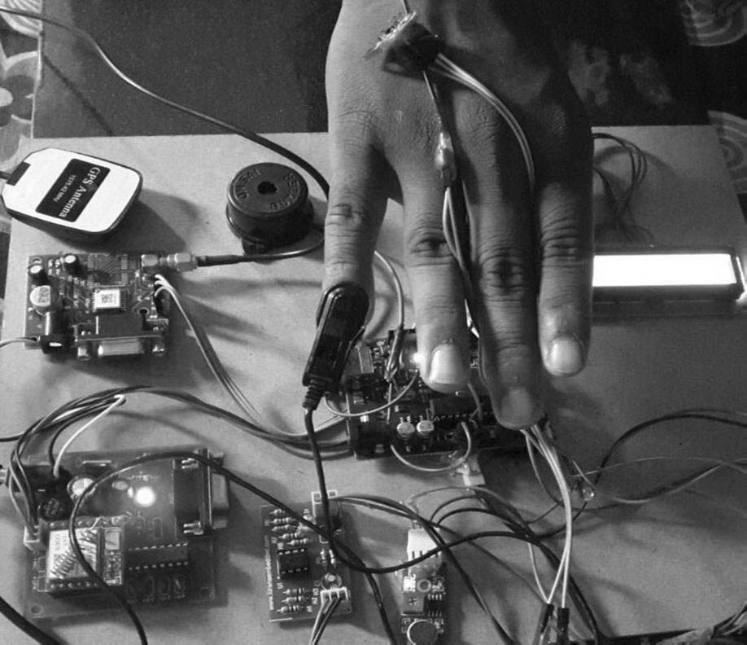
EXISTING SYSTEM
In an existing for women safety there is no self defense is present. They are always depends on others for their safety in an existing system.
The cost of an existing system is more. The accuracy is also less. Only button system is available in an existing system.

Slide 11

PROBLEM DEFINITION EXISTING SYSTEM
C/C++ Language
Expensive
More number of sensor have been used.
No live streaming video
No self defence

Slide 12

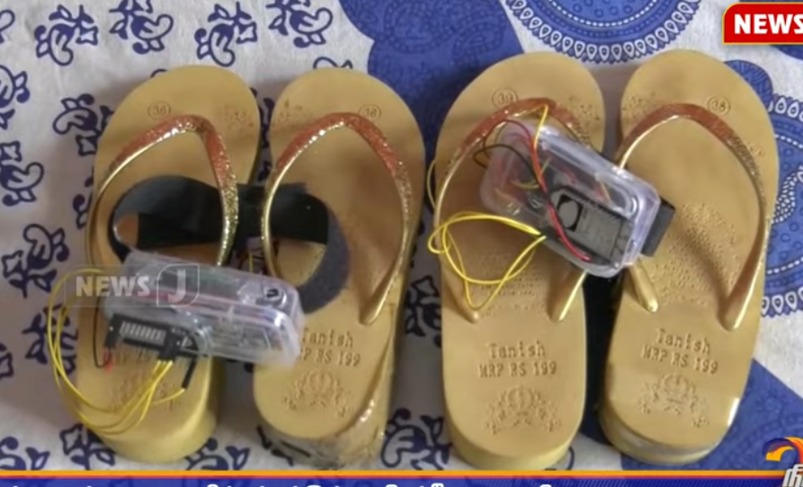
PROPOSED SYSTEM
The proposed system provides self security to the women. In this system there are two inputs are available. They are detection of abnormal sound and detection of abnormal movement.
The microcontroller used in this system having wifi connection itself. So there is no need of separate wifi connection of the size of proposed system is compact. It also gives alert signal to the local area.

Slide 13
PROPOSED SYSTEM DESIGN
BATTERY
WRIST BAND
PRESURE SWITCH
PIC
MEMS
RF TX
MICROPHONE

Slide 14
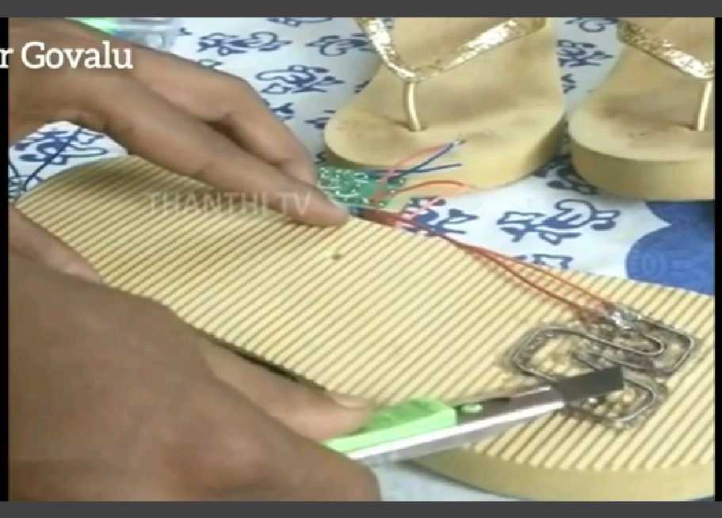
PROPOSED SYSTEM DESIGN
BATTERY
RF RX
RELAY
ELECTRODE
Shock
ALARAM

Slide 15
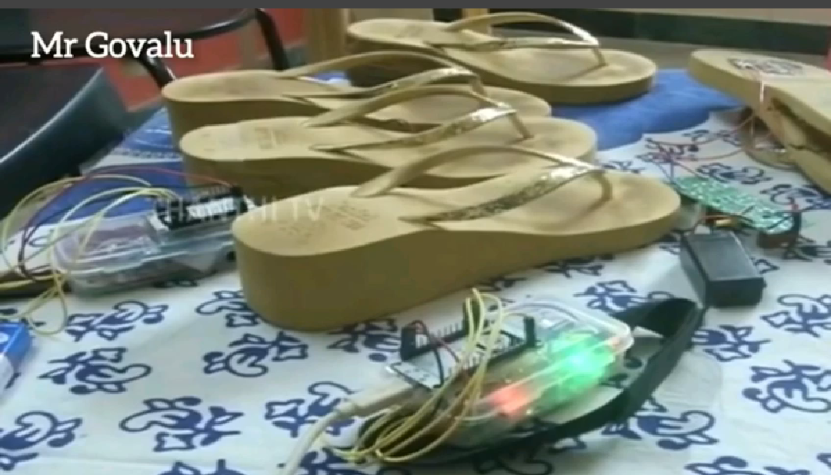
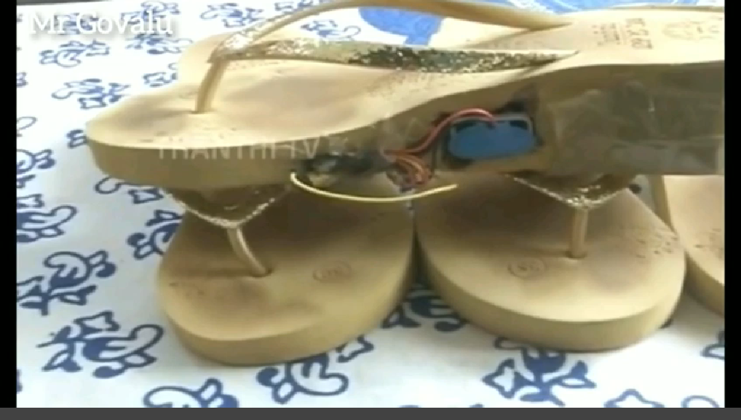
PROTOTYPE

Slide 16

ADVANTAGES+FUTURE
Tear gas mechanism
PIC controller
Alternatives are more
Accuracy is more
Efficiency is higher
Cost effective

Slide 17



APPLICATIONS
It is used for safety of women.
It can also be used for child tracking during school time.

Slide 18


CONCLUSION
This system can overcome the fear that scares every woman in the country about her safety and security.

Slide 19


Slide 20


